Slide 1
SUBRINGS
BY
K. Shalini
Lecturer in Mathematics
Skr & Skr Govt. College for Women,
Kadapa.

Slide 2
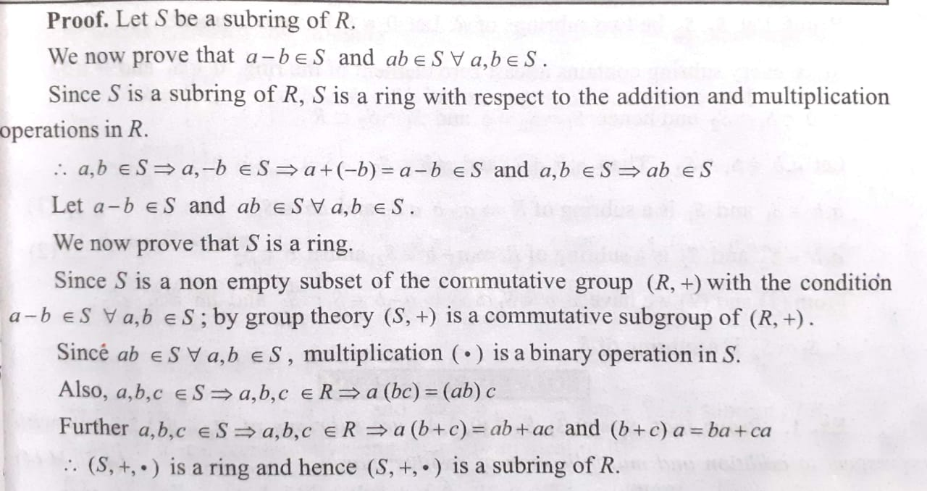

Subrings:
Def: Let (R,+,.) be a ring and S be a non-empty subset of R. If (S,+,.) is also a ring w.r.to operations then (S,+,.) is a subring of R
Theorem: Let S be a non empty subset of a ring R. Then S is a subring of R iff a-b$∈$S and ab $∈$S

Slide 3
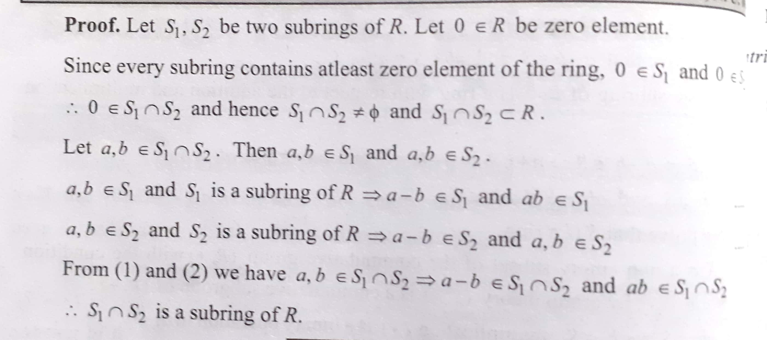
Theorem: The intersection of two subrings of a ring is also a subring of R

Slide 4
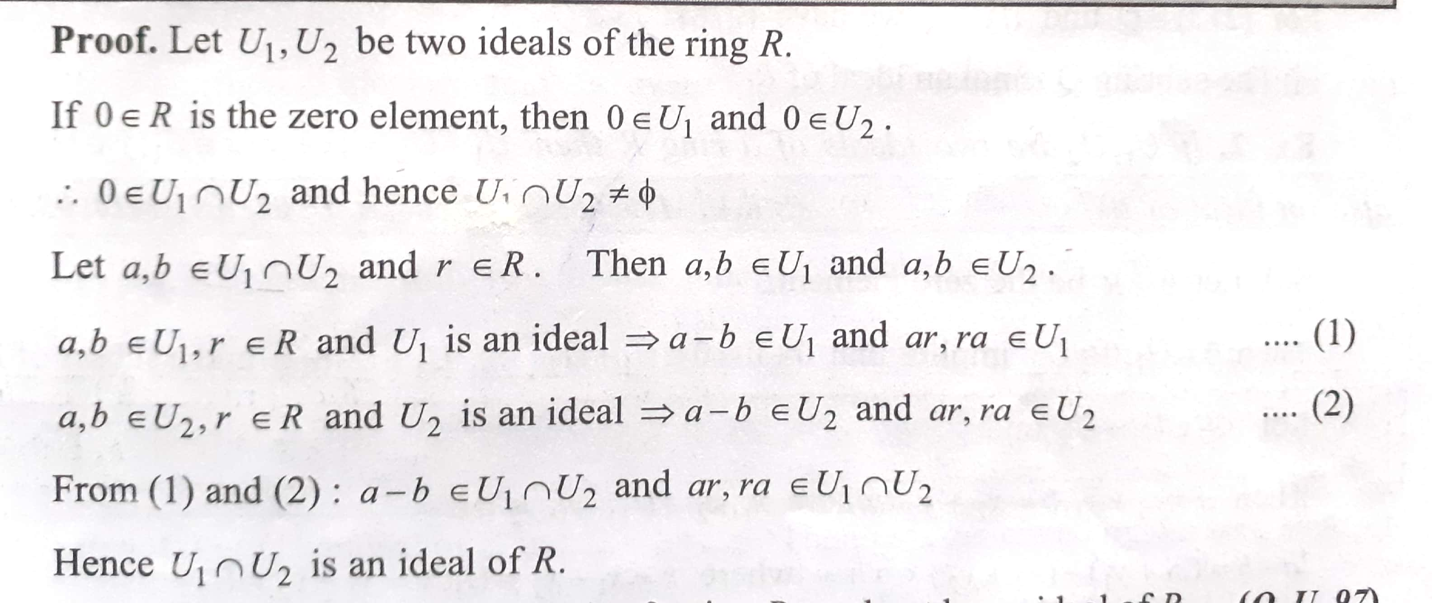

Ideals
Def: Let (R,+,.) be a ring. A non empty susbset U of R is called an Ideal if i)a,b$∈$U$→$ a-b $∈$U ii) a $∈$U and r $∈$R$→$ar,ra $∈$U
The intersection of two ideals of a ring R is an ideal of R

Slide 5
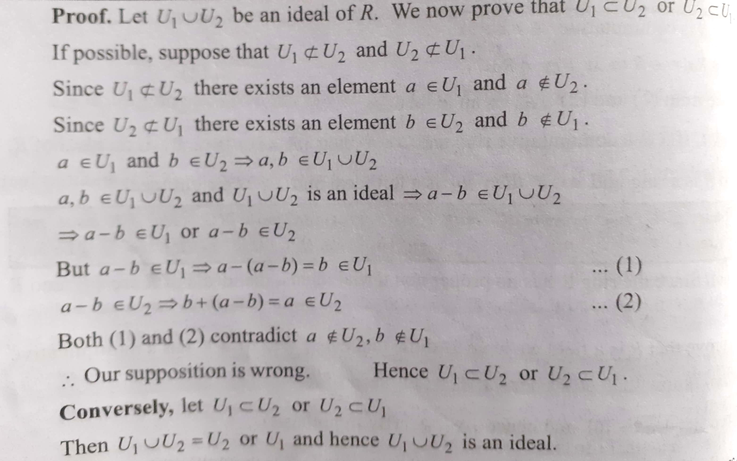
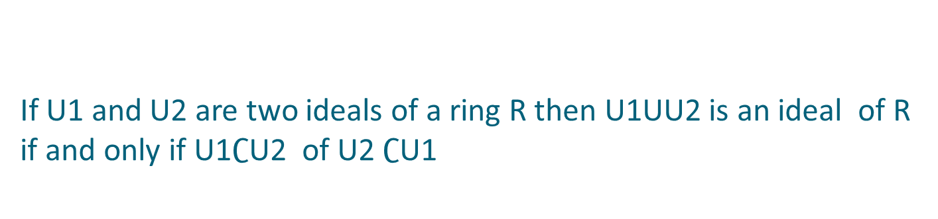
If U1 and U2 are two ideals of a ring R then U1UU2 is an ideal of R if and only if U1$∁$U2 of U2 $∁$U1

Slide 6
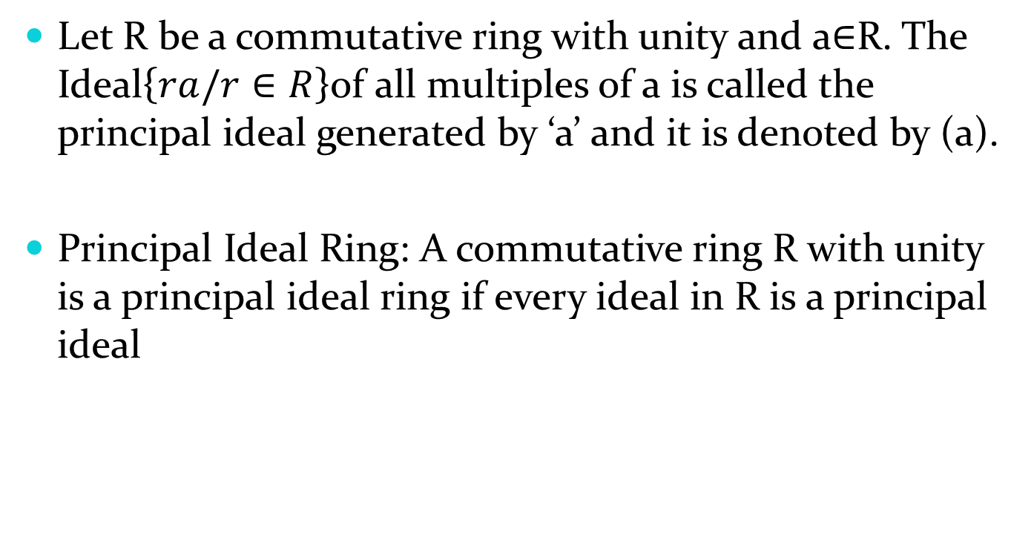
Principal Ideals
Let R be a commutative ring with unity and a$∈$R. The Ideal$\left\{ra/r∈R\right\}$of all multiples of a is called the principal ideal generated by ‘a’ and it is denoted by (a).
Principal Ideal Ring: A commutative ring R with unity is a principal ideal ring if every ideal in R is a principal ideal

Slide 7
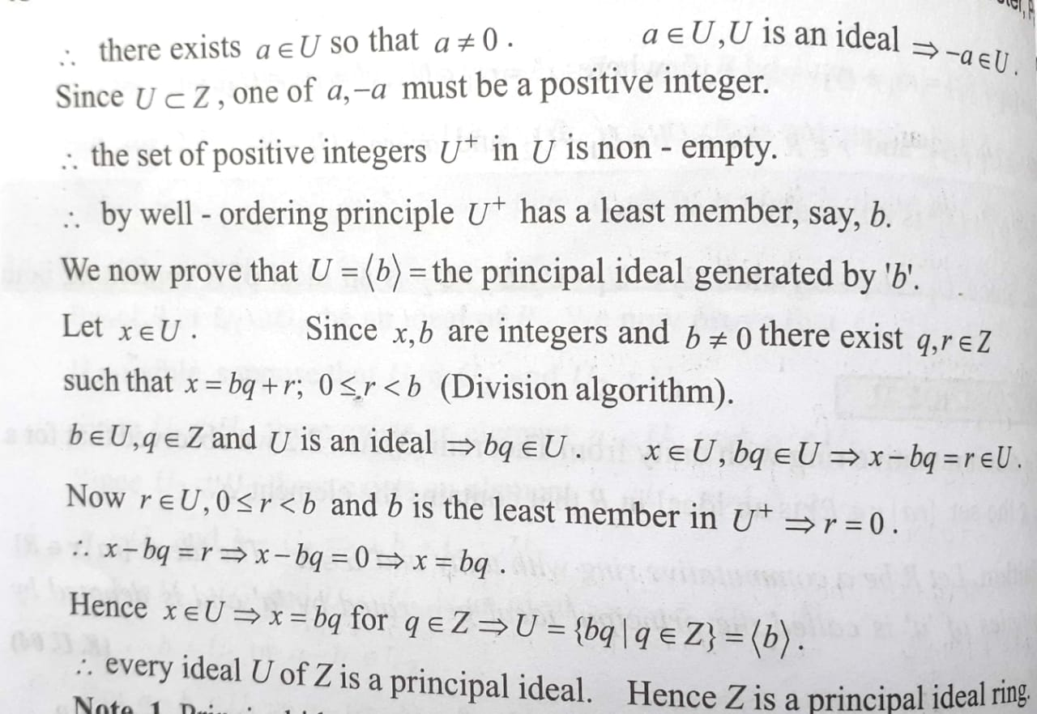
Theorem: The ring of Integers is a principal ideal ring

Slide 8
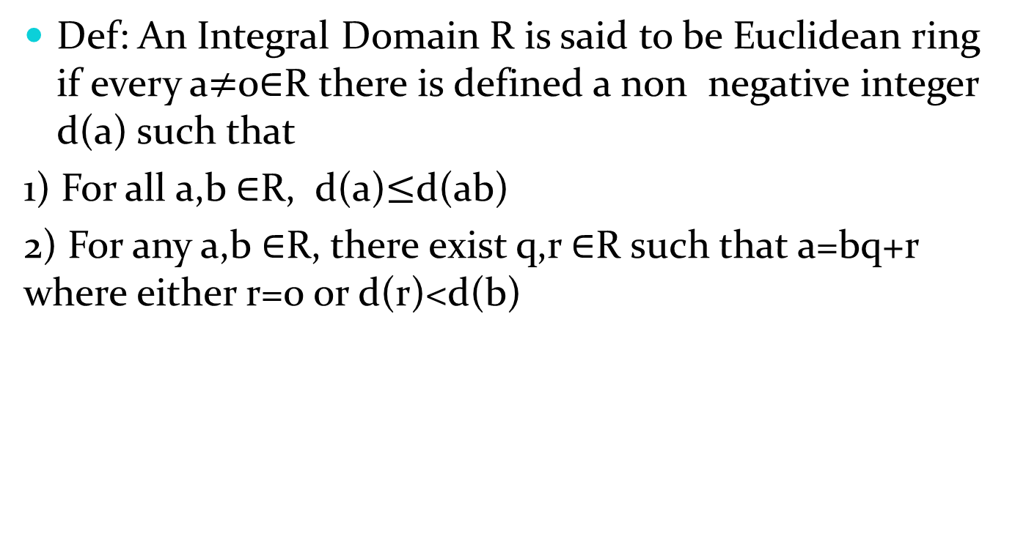
Euclidean Rings
Def: An Integral Domain R is said to be Euclidean ring if every a$≠$0$∈$R there is defined a non negative integer d(a) such that
1) For all a,b $∈$R, d(a)$≤$d(ab)
2) For any a,b $∈$R, there exist q,r $∈$R such that a=bq+r where either r=0 or d(r)<d(b)

Slide 9
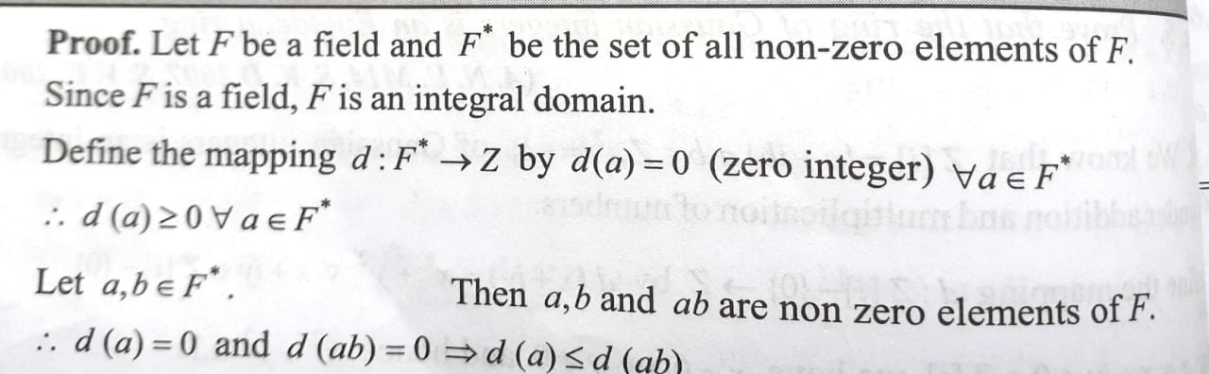
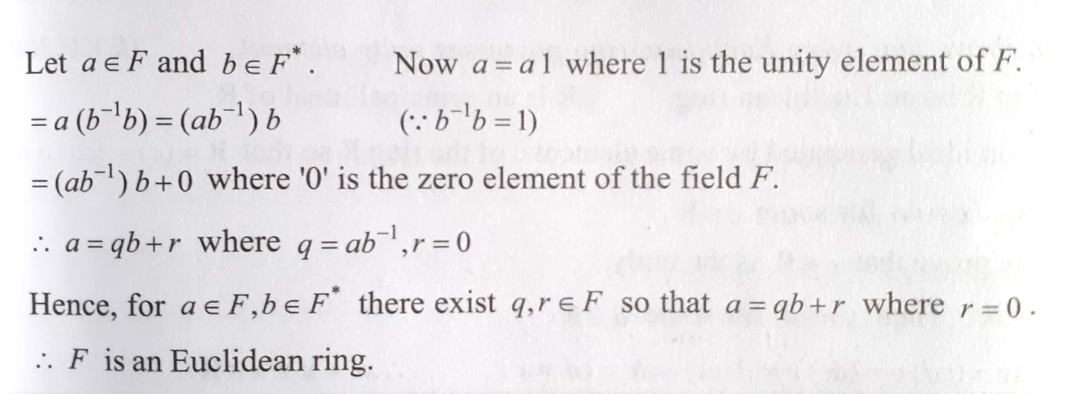
Theorem: Every field is a Euclidean Ring

Slide 10
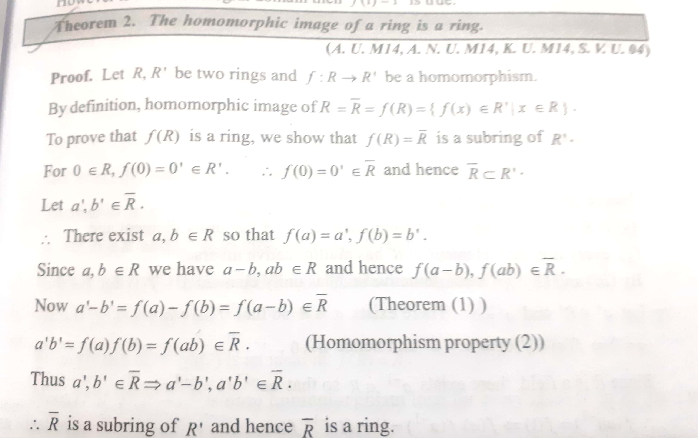
Homomorphisms
Let R,R’ be two rings. A mapping f:R R’ is said to be homomorphism if
a) f(a+b)=f(a)+f(b) b) f(ab)=f(a)f(b) Theorem: The homomorphic image of a ring is a ring

Slide 11
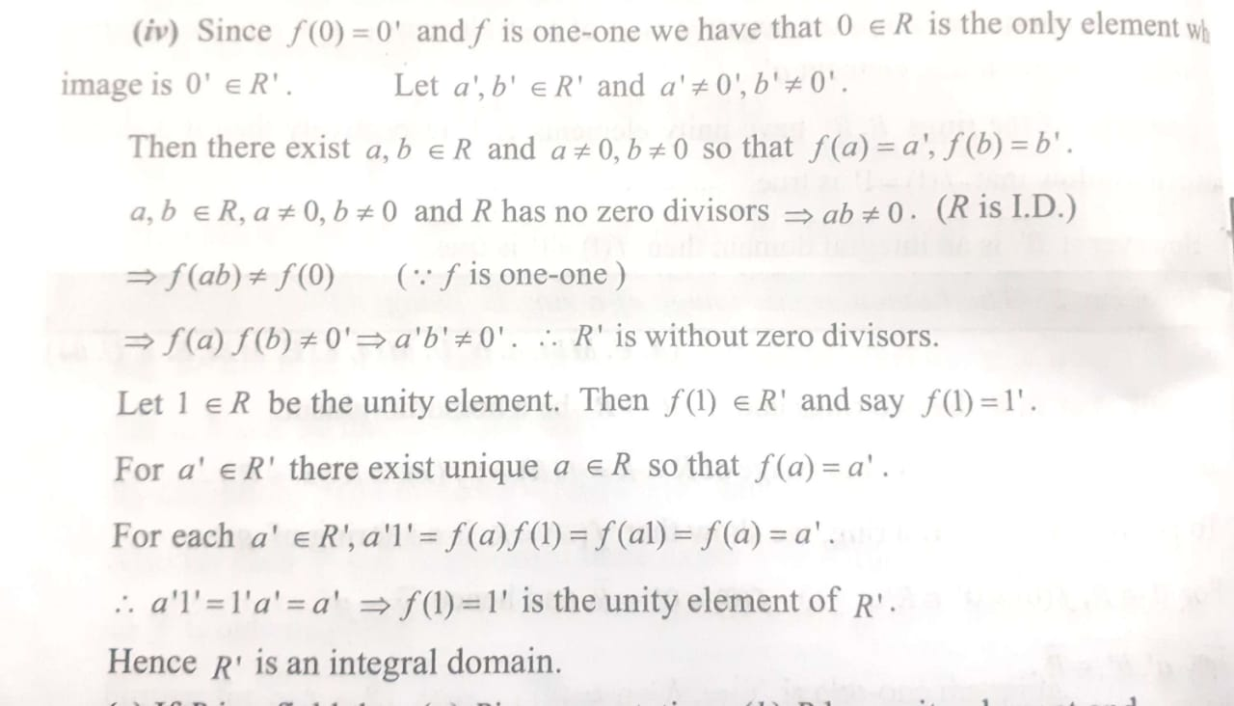
R’ is an Integral domain if R is an Integral domain

Slide 12
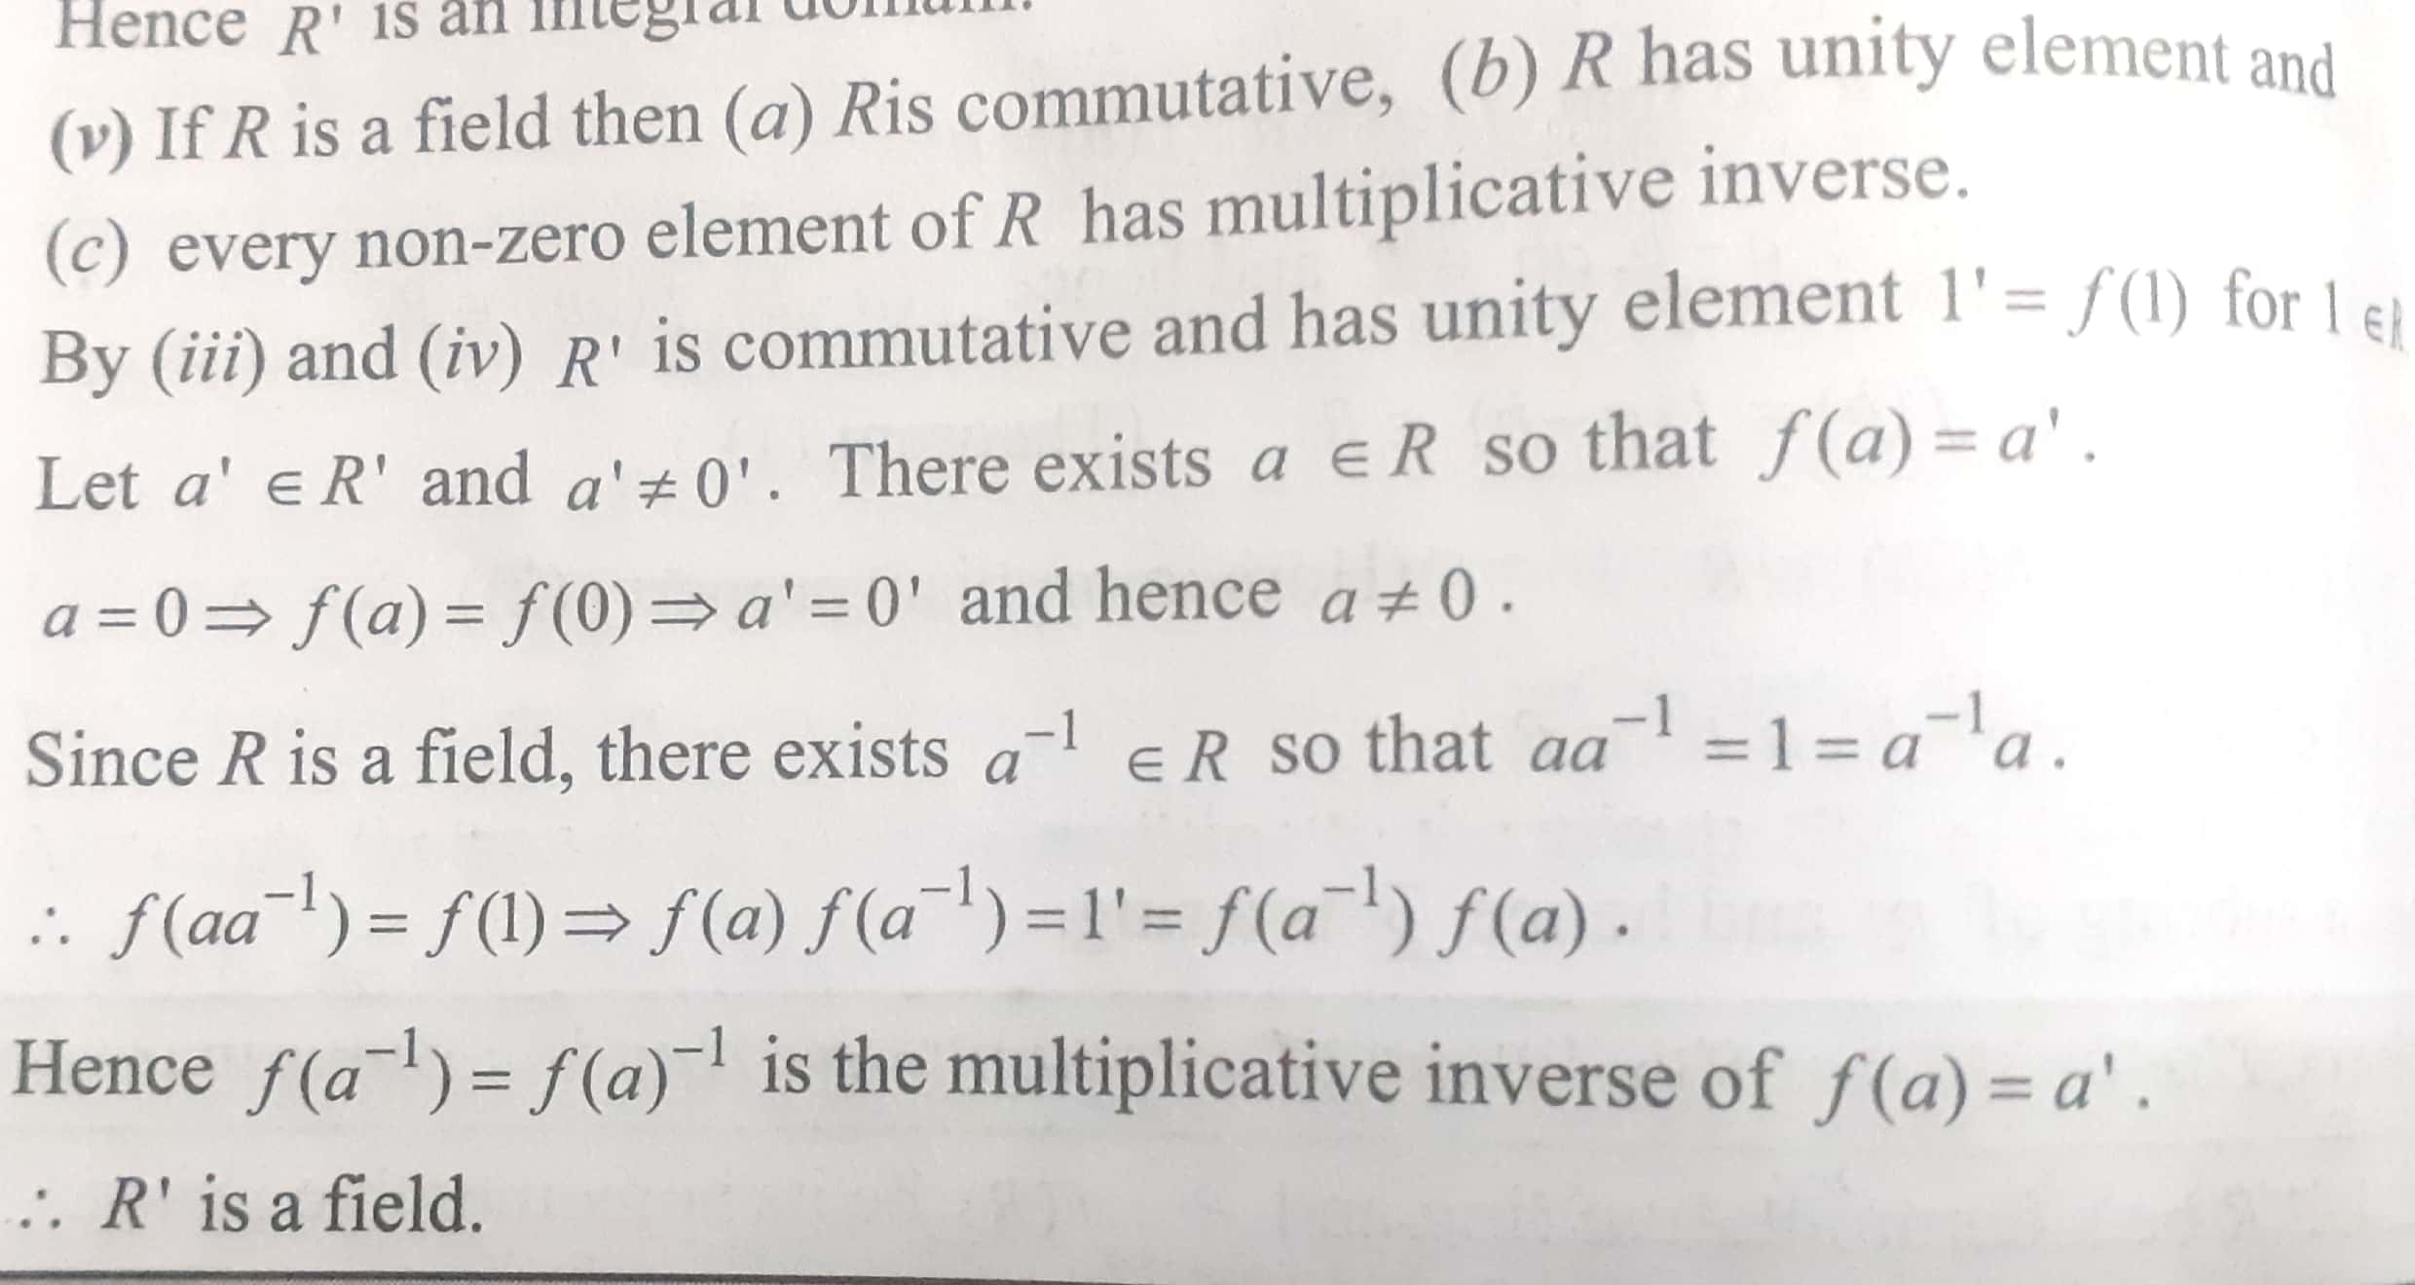
R’ is a field if R is a field

Slide 13
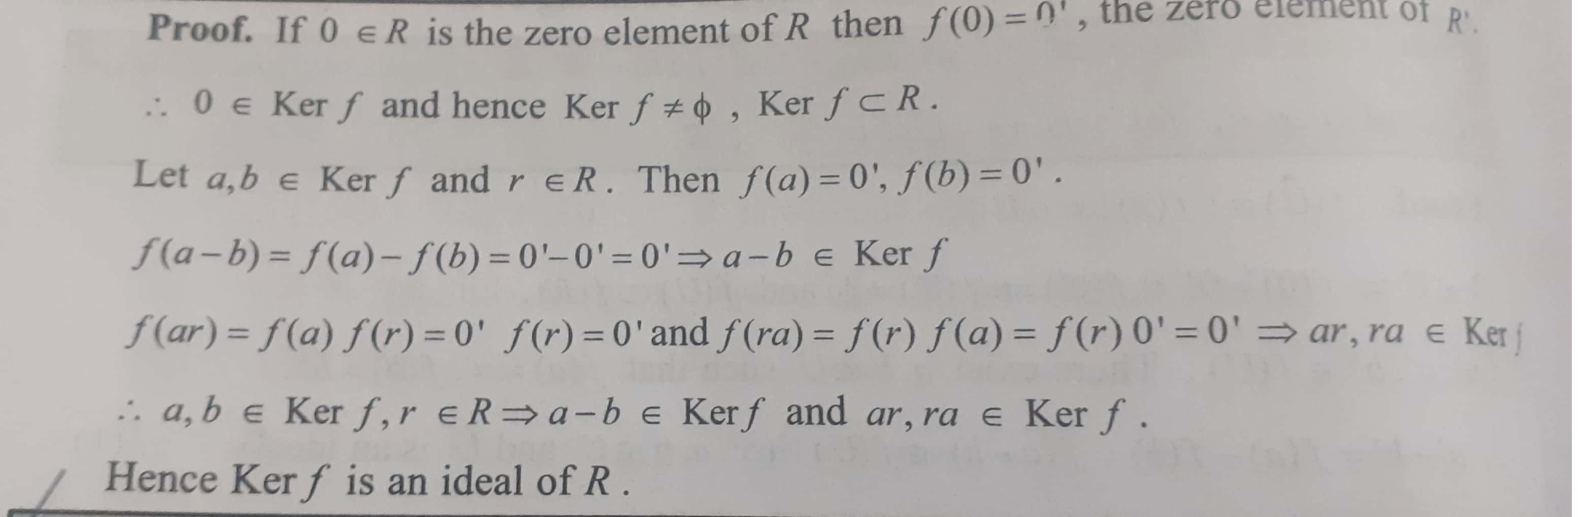

Kernel of a Homomorphism
Let R, R’ be two rings and $f:R→R′$ be a homomorphism. The set $\{x∈R$/$f\left(x\right)=0′$} is defined as the Kernel of the homomorphism.
Theorem: If f is a homomorphism of a ring R into a ring R’ then Kerf is an ideal of R

Slide 14
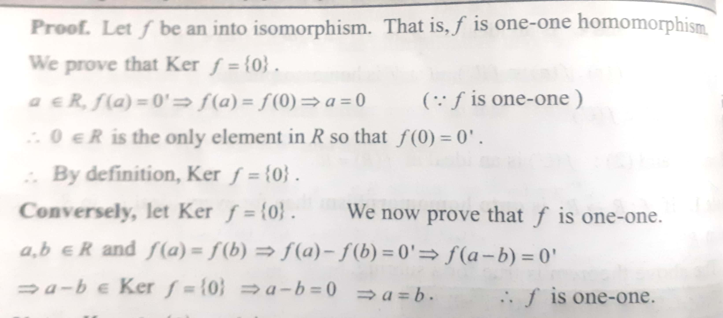
If f is a homomorphism of a ring R into R’ then f is an onto isomorphism iff kerf={0}

Slide 15
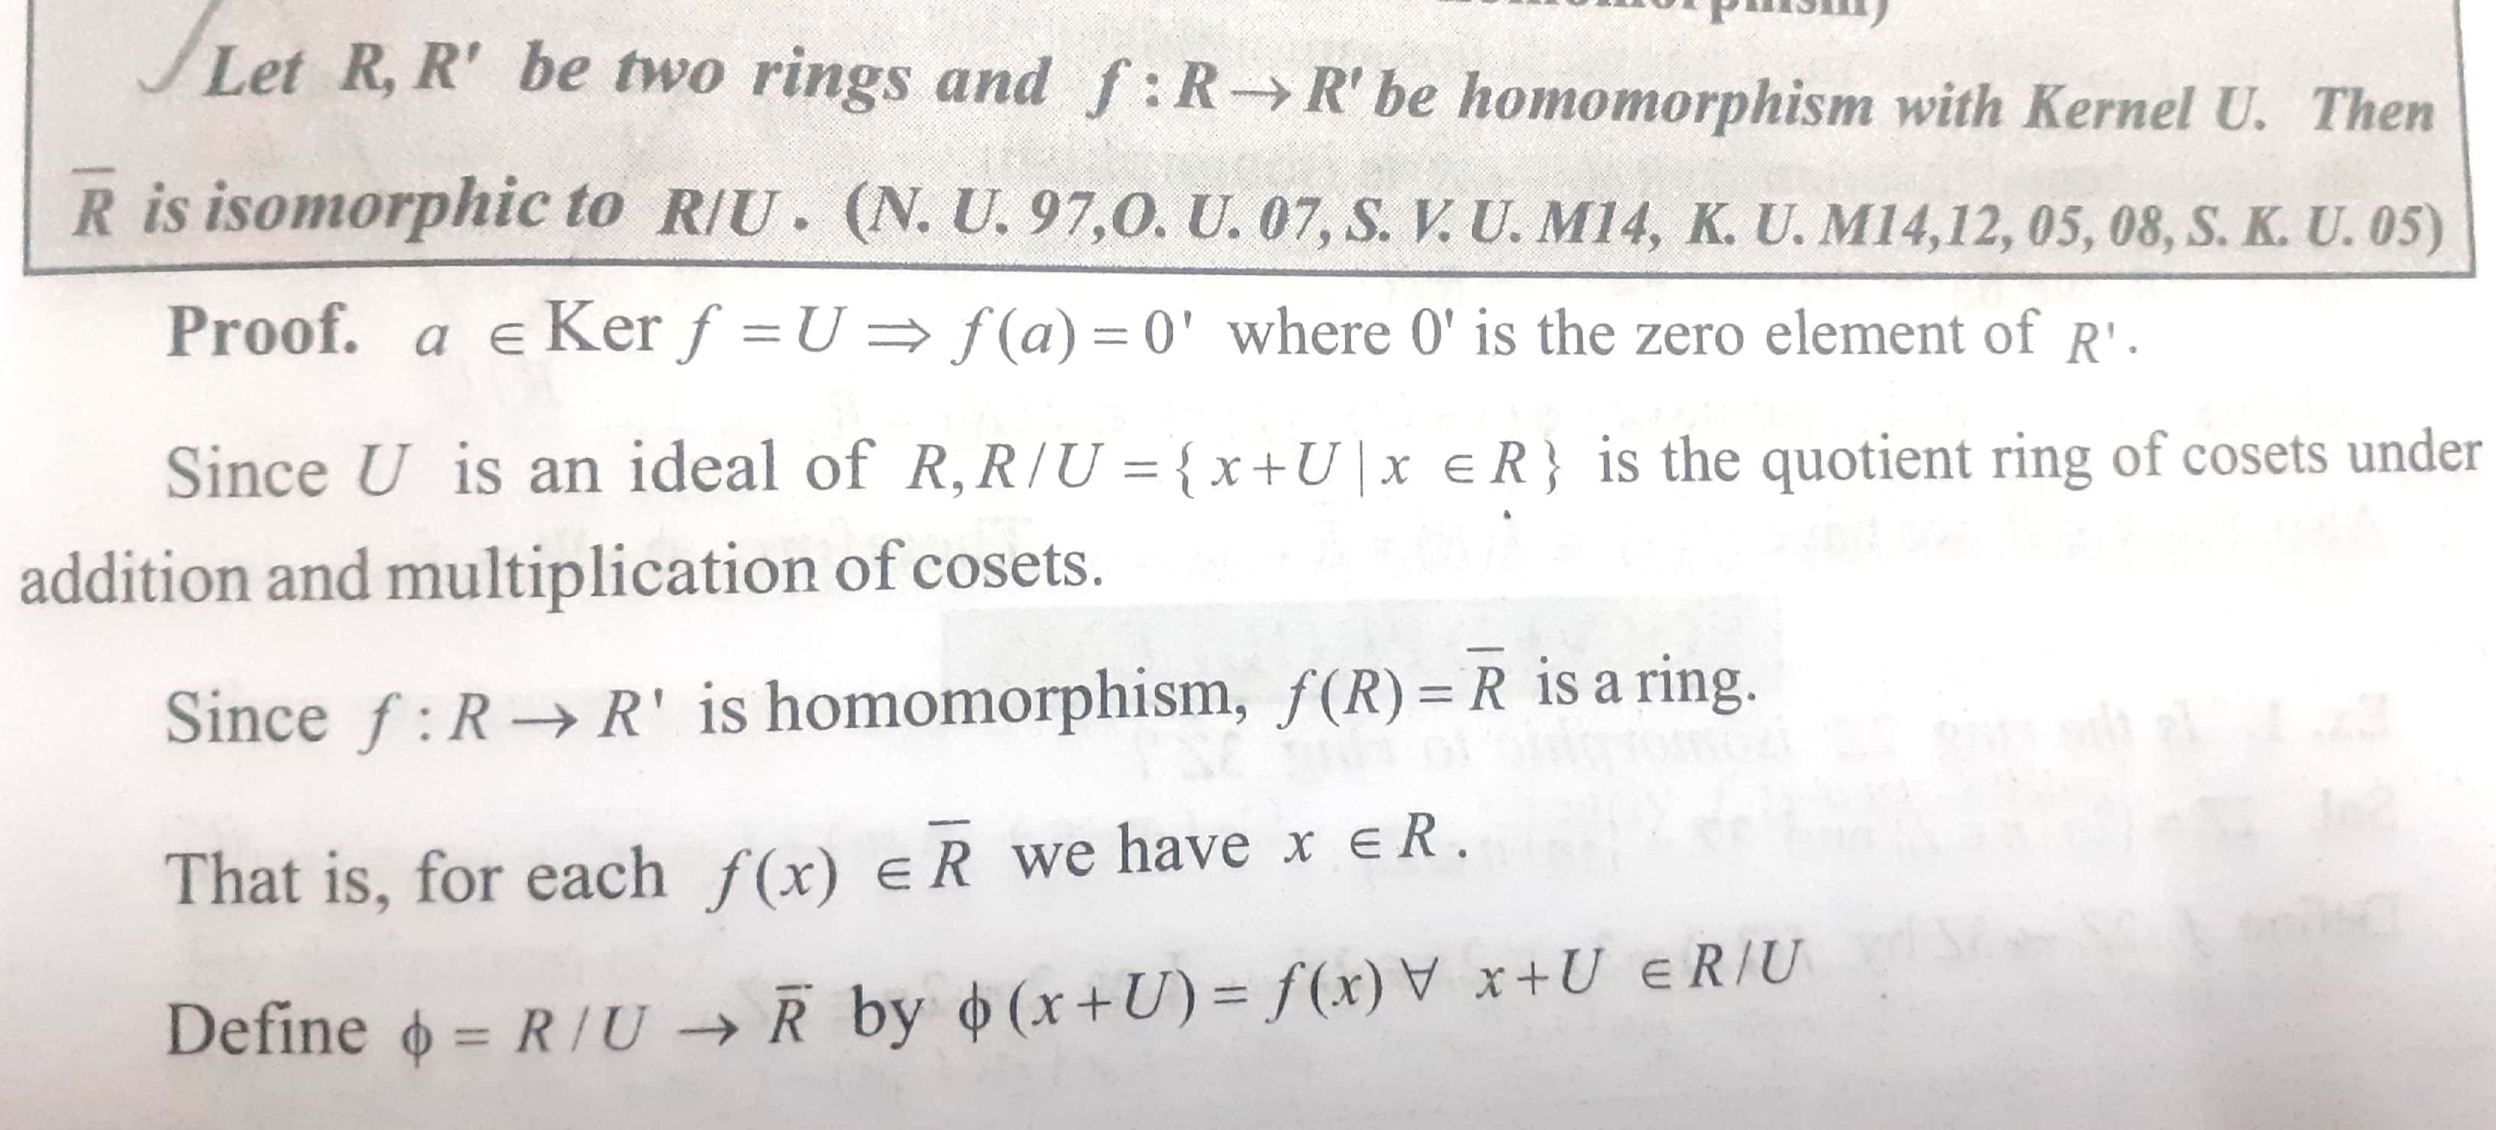
Fundamental theorem of Homomorphism

Slide 16
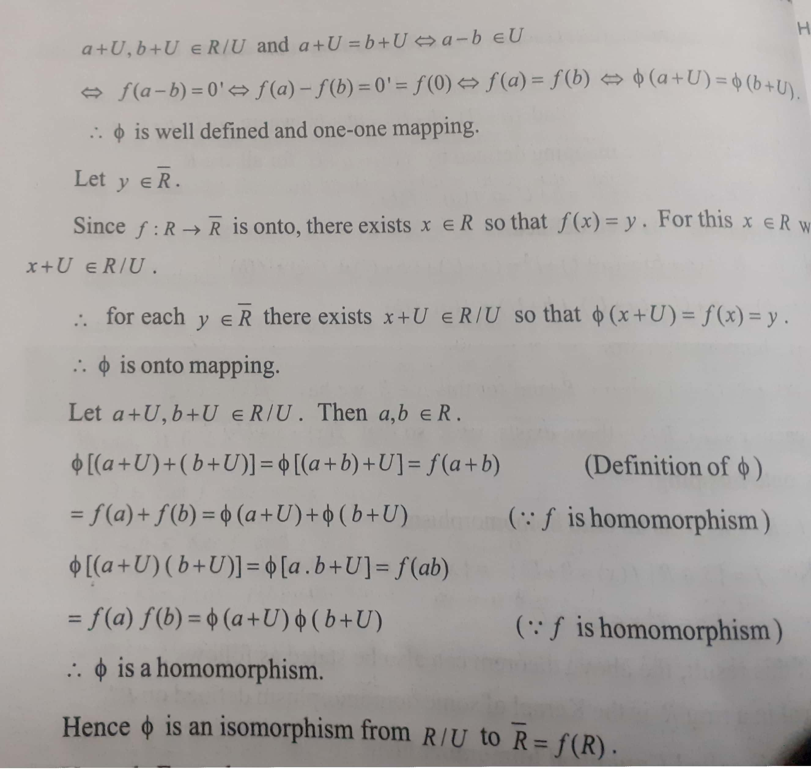

Slide 17
THANK YOU

